Slide 2
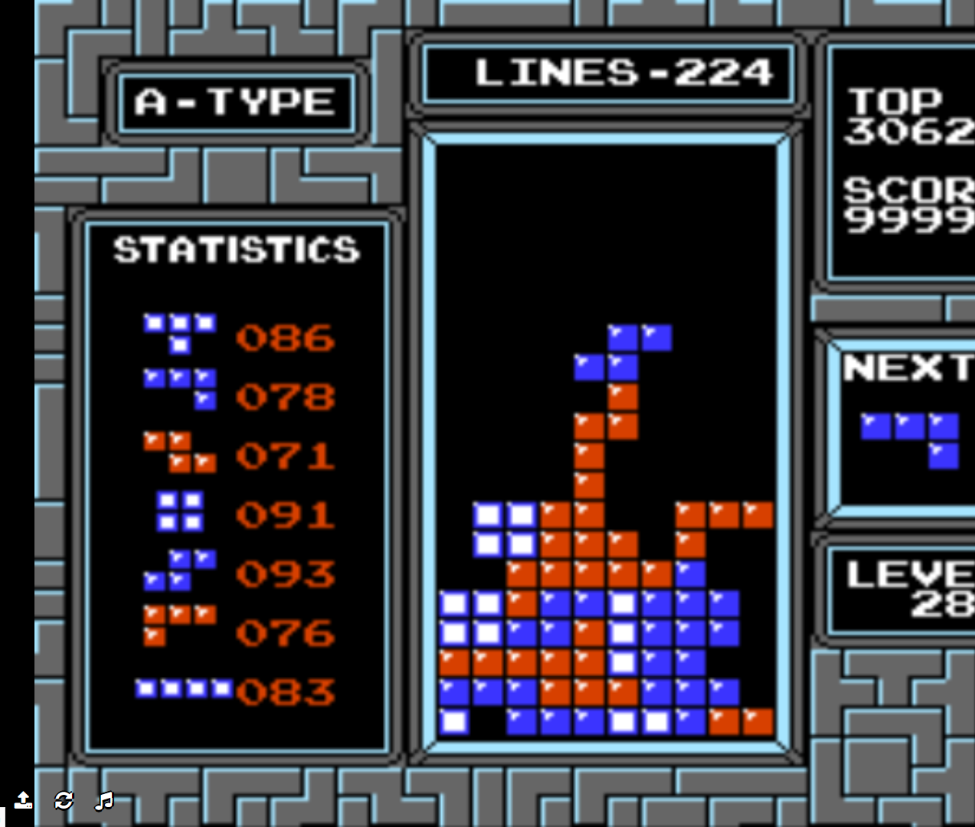
Tetris
At the next level

Slide 3
Onderwerpen
Korte Geschiedenis
Klassieke Tetris
Randomizer
Tetris stacking
T-Spins
Moderne Tetris
7Bag
Perfect Clear
4Wide
Openers
The End
Sliding
Technieken

Slide 4
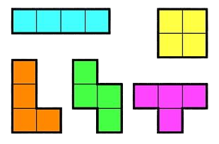
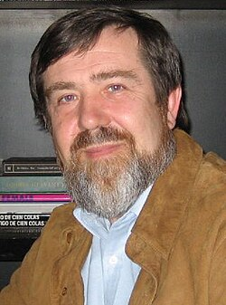
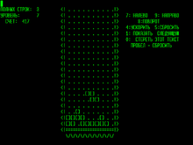
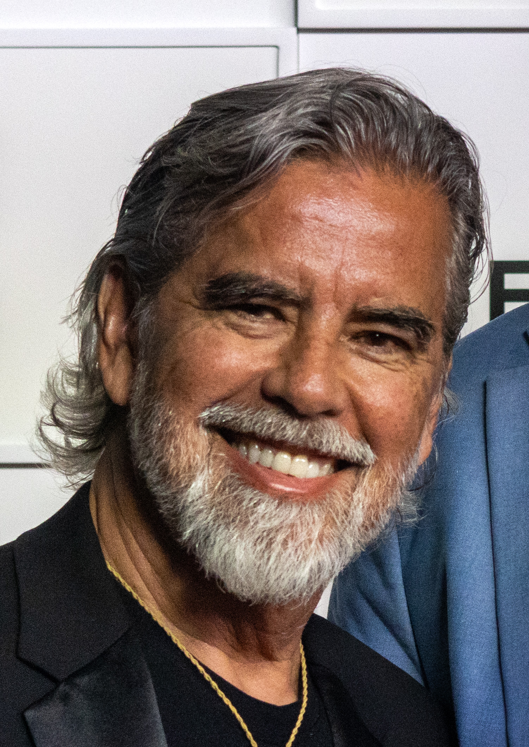
Korte Geschiedenis
1984
Alexey Pajitnov
1988
Henk Rogers
Bron : https://tetris.com/news/the-history-of-tetris

Slide 5
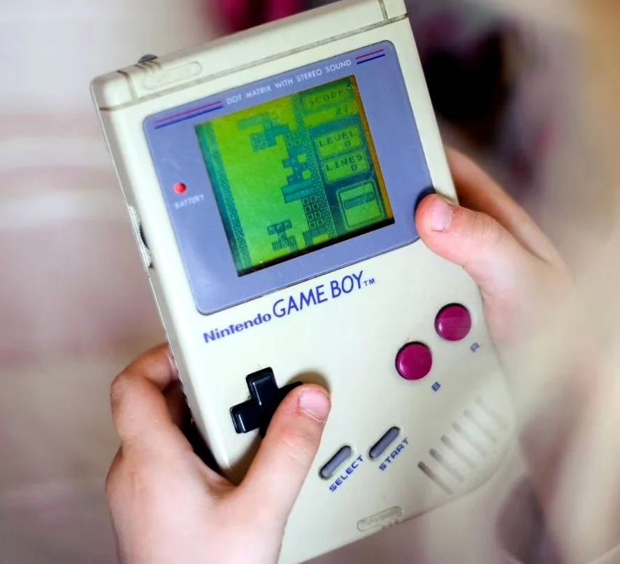
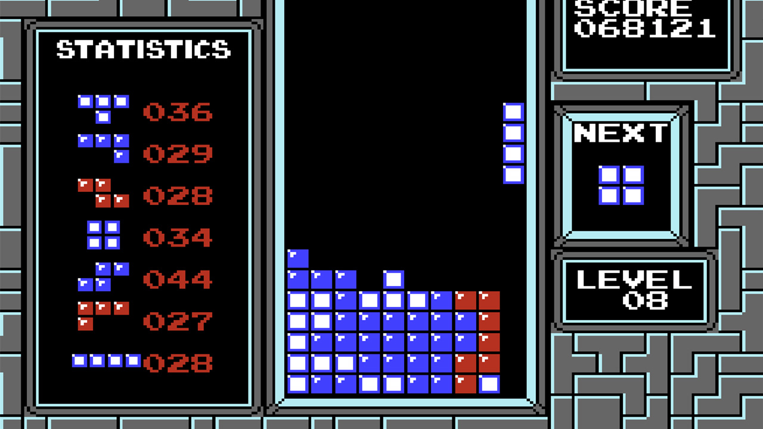
Klassieke Tetris

Slide 6
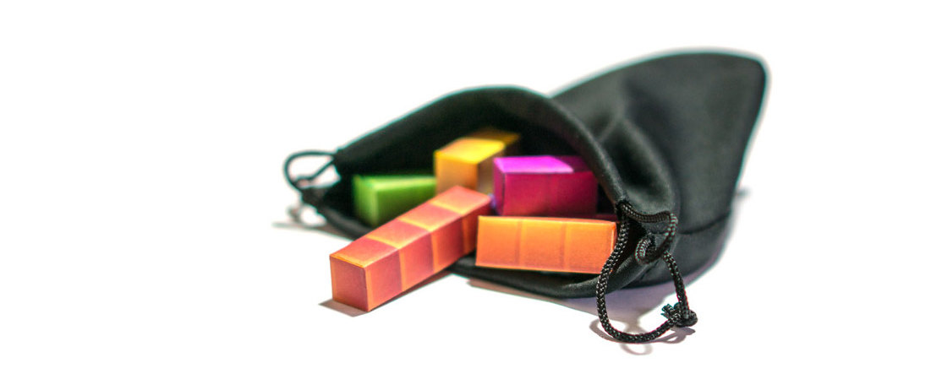
Randomizer

Slide 7
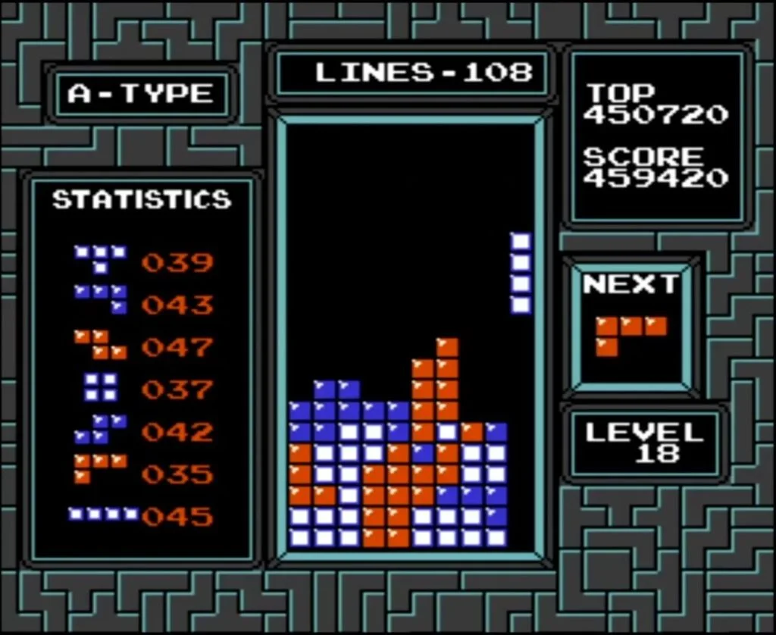
Tetris stacking

Slide 8
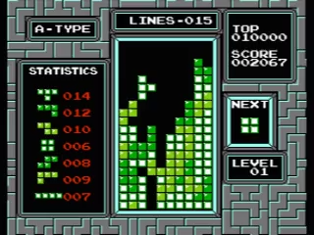
T-spins

Slide 9
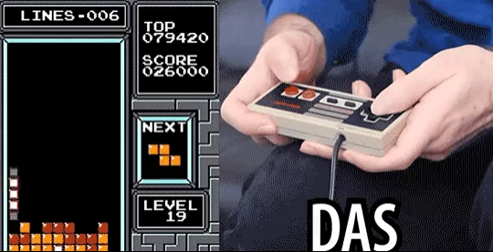
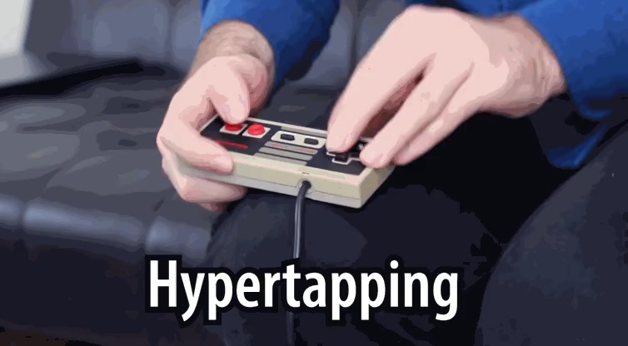
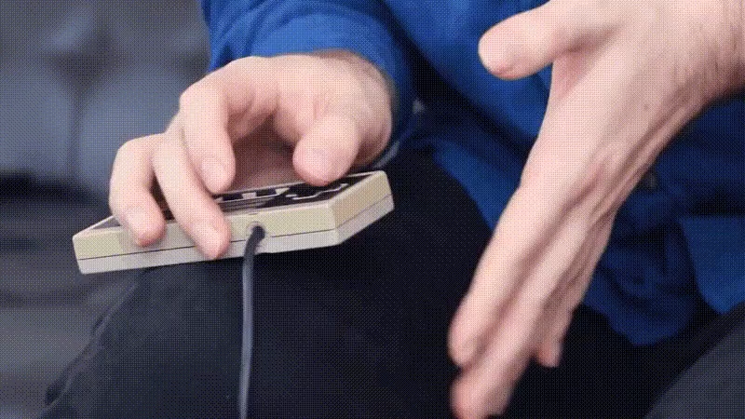
Technieken
DAS (Delayed Auto Shift)
Hypertapping
Rolling

Slide 10

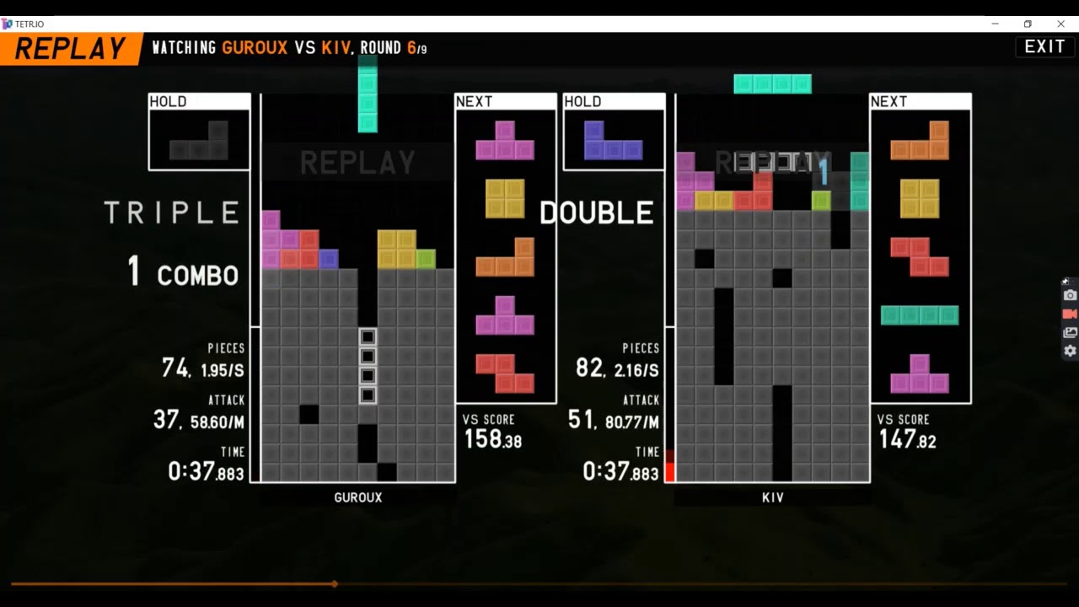
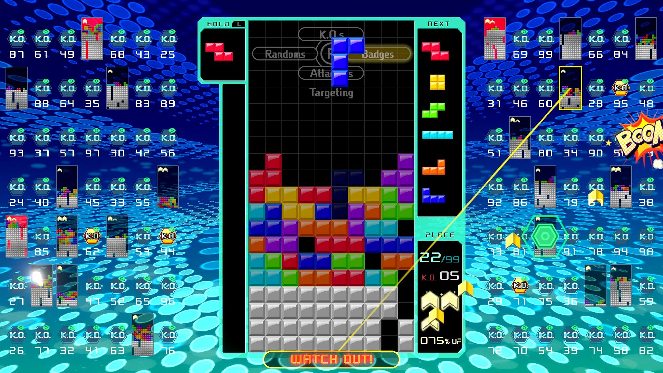
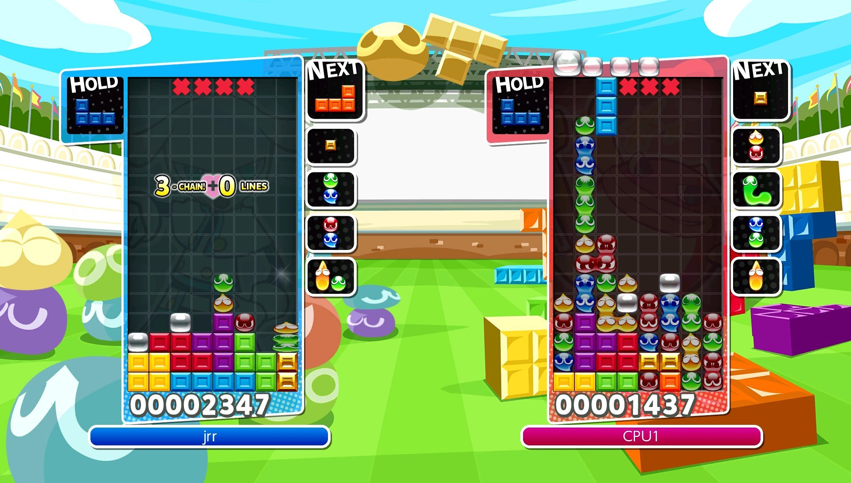
Moderne tetris

Slide 11
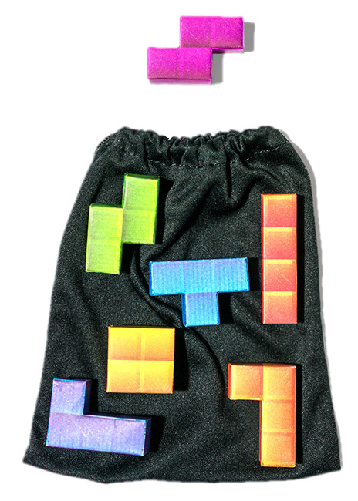
7 Bag

Slide 12
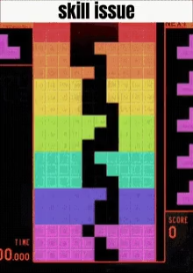
Sliding

Slide 13
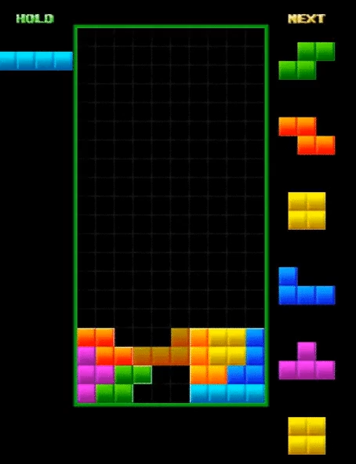
Perfect clear

Slide 14
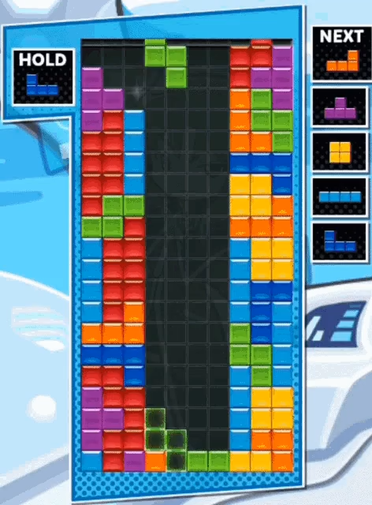
4wide

Slide 15
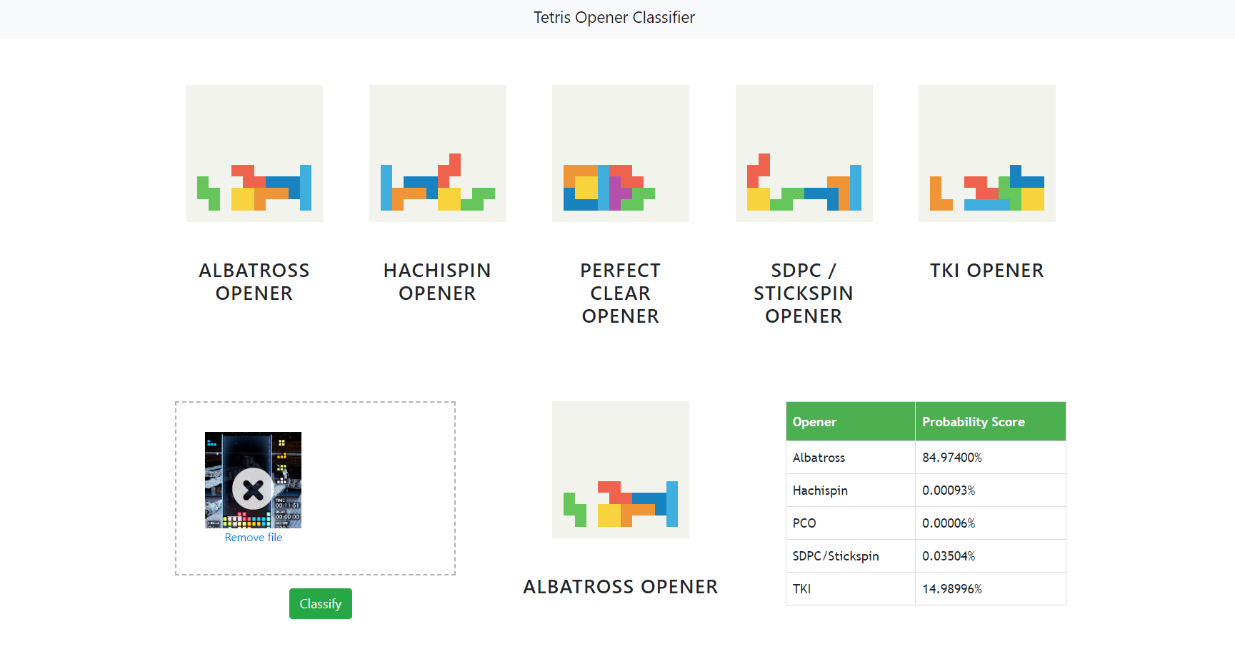
Openers
Bron : https://github.com/quickandsmart/tetris-opener-classifier

Slide 16
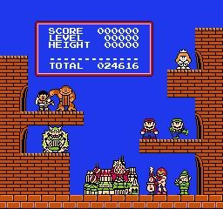
The end

